Slide 1

Rapid Response Team Activations in SGH
By Matthew Pan

Slide 2
Introduction
Timeframe
Apr 2019 to Mar 2021
Data Source
SICU and MICU Triages from SGH
Patient Outcomes from SGH
Objective
To analyze the factors influencing the number of RRT activations such as Teams (SICU VS MICU Triage) and Hours (Office VS Non-Office).
To analyze the impact of RRT activations on immediate Disposition and hospitalization Outcome.
Explanation of Terms
SICU Triage Team: Rapid Response Team responsible for Surgical Intensive Care Unit (SICU) triages.
MICU Triage Team: Rapid Response Team responsible for Medical Intensive Care Unit (MICU) triages.
Disposition: Immediate disposition of patient after being seen by either SICU or MICU Triage Teams.
Outcome: Final outcome of patient’s hospitalization, 1 outcome per hospitalization.
Data Limitations
Unable to differentiate between different hospitalizations for the same patient, difficulty in matching outcomes to triage data when there are multiple outcomes per patient

Slide 3
RRT Activations Across Time by Teams
140
MICU Triage Team
SICU Triage Team
Huge dip in MICU triage team activations during height of COVID-19 pandemic.
Reduction in MICU triages due to reallocation of resources for potential COVID-19 surges.
The SICU triage team is responsible for surgical patients needing intensive care.
SICU triage volume remained stable as essential surgeries were not affected during the pandemic.
120
100
80
No. of RRT Activations
60
40
20
0
Mar 2019
Sept 2019
Mar 2020
Sept 2020
Mar 2021
Date

Slide 4
RRT Activations Across Time by Outcomes
90
80
Huge spike in patient deaths during initial onset of COVID-19 pandemic.
SGH experienced significant decline in Follow-ups at Clinics during height of COVID-19 pandemic due to reallocation of MICU resources to prepare for COVID-19 surges
70
60
50
No. of RRT Activations
40
30
20
Absconded
Follow-up at Clinic
10
AOR
Others
Death
Residential Stepdown
Discharged
Transferred
0
Mar 2019
Sept 2019
Mar 2020
Sept 2020
Mar 2021
Date

Slide 5
RRT Activations During Office VS Non-Office Hours
Non-Office Hours
Office Hours
Typically, RRTs after office hours are lower in volume. The data appears to contradict that.
Due to influx of Covid-19 hospitalisations, more emergencies happening after hours when there are less hospital staff and higher reliance on RRT activations.
42.9%
1,422
RRT Activations
57.1%
1,890
RRT Activations
Office Hours: Weekday 8 am – 4:59 pm and Saturday 8 am – 11:59 pm
Non-Office Hours: Weekday 5 pm – 7:59 am, Saturday 12 pm – 7:59 am, Sundays, and Public Holidays

Slide 6
RRT Activations by Disposition and Teams
MICU Triage Team
SICU Triage Team
Majority of MICU triages led to GW dispositions.
Partially contributed by the constraint in ICU and HDU resources during the pandemic. As a result, patients had to be admitted to general wards instead.
1,029 (96%)
No. of RRT Activations
650 (80%)
613 (96%)
614 (99%)
GW: General Ward
ICU: Intensive Care Unit
HDU / ICA: High Dependency Unit or Intermediate Care Area
ICA: Intermediate Care Area
HDU: High Dependency Unit
167 (20%)
130 (75%)
38 (4%)
43 (25%)
GW
ICU
HDU / ICA
ICA
HDU
Disposition and Teams

Slide 7
RRT Activations by Disposition and Outcomes
35 (3%)
Absconded
Follow-up at Clinic
AOR
Others
Death
Residential Stepdown
Highest number of General Ward (GW) dispositions after RRT activations.
32% of GW dispositions have led to patient deaths likely because critical patients are being admitted to general wards due to capacity constraints during COVID surges
345 (32%)
Discharged
Transferred
367 (45%)
No. of RRT Activations
156 (25%)
128 (21%)
524 (49%)
322 (51%)
361 (58%)
295 (36%)
GW: General Ward
ICU: Intensive Care Unit
HDU / ICA: High Dependency Unit or Intermediate Care Area
ICA: Intermediate Care Area
HDU: High Dependency Unit
94 (9%)
80 (10%)
110 (17%)
105 (61%)
38 (4%)
56 (9%)
GW
ICU
HDU / ICA
ICA
HDU
Disposition and Outcomes

Slide 8
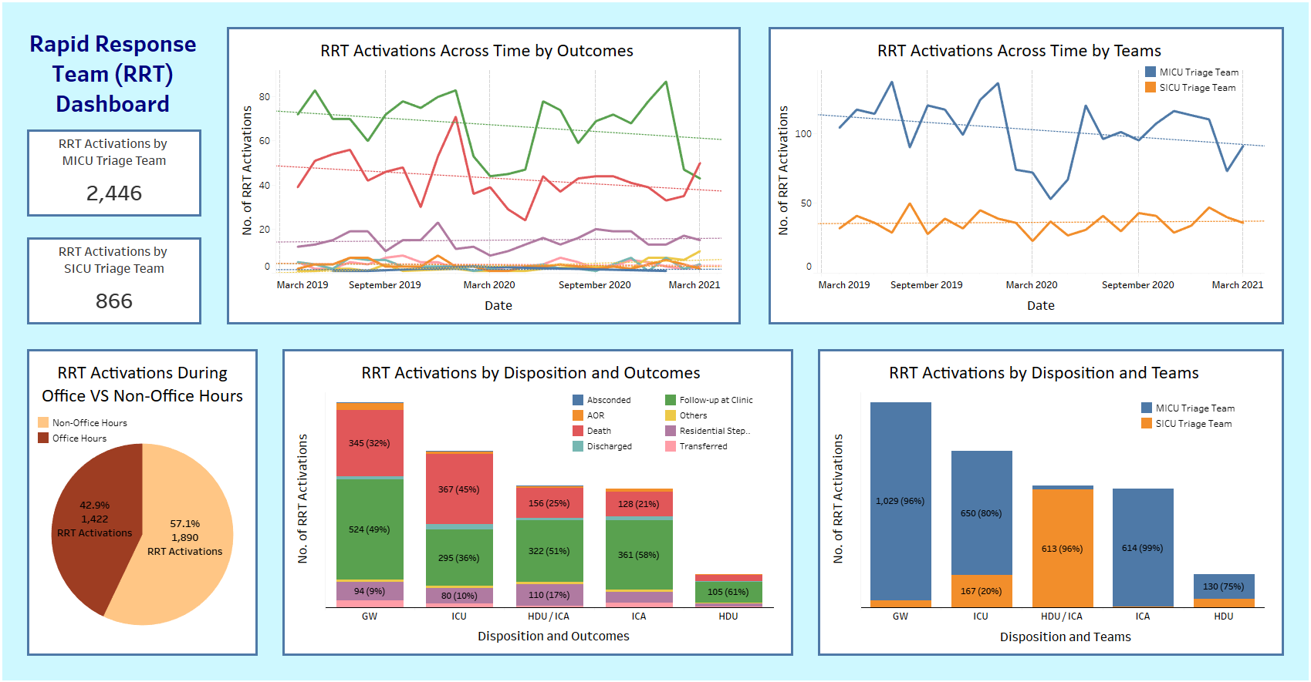
RRT Dashboard

Slide 9
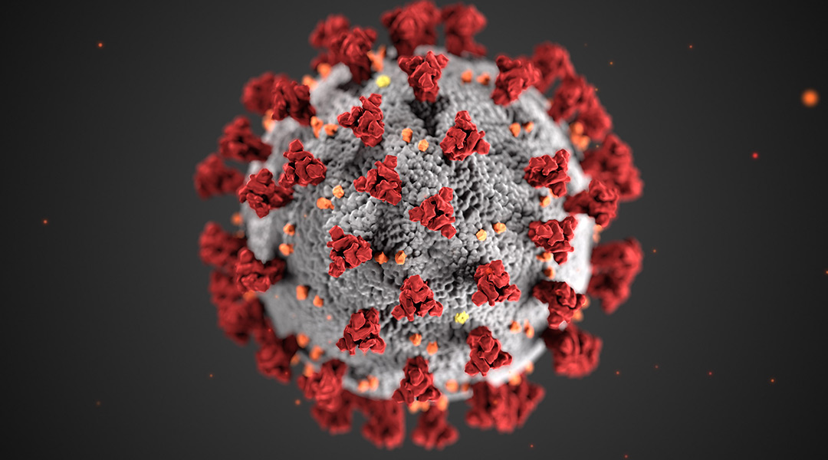
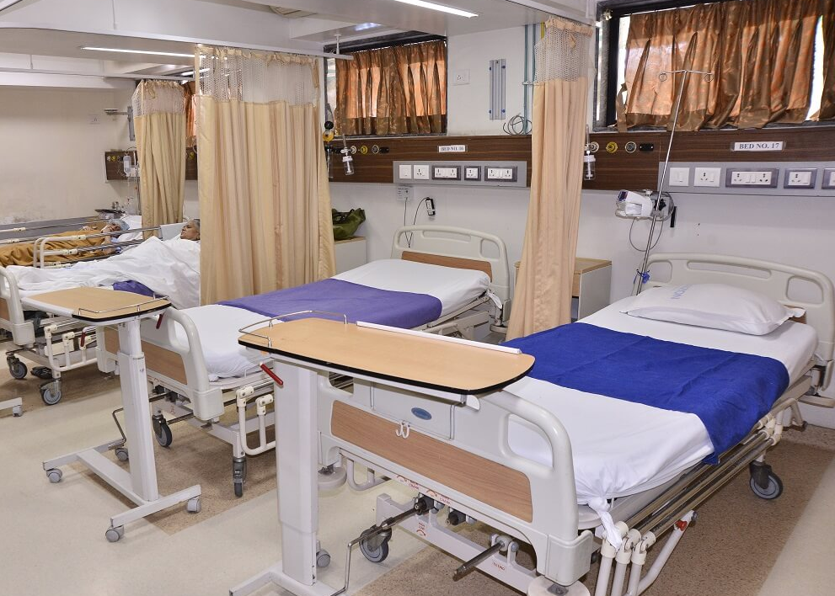

Summary and Insights
RRT Activations Across Time
Significant reduction in MICU triages due to reallocation of resources to prepare for potential COVID-19 surges. Essential SICU triages not affected.
Huge spike in patient deaths during initial onset of COVID-19 pandemic.
RRT Activations During Office VS Non-Office Hours
Higher number of RRTs after office hours.
Due to influx of Covid-19 hospitalisations, more emergencies happening after hours when there are less hospital staff and higher reliance on RRT activations.
More manpower should be allocated after office hours during the pandemic or for any health crisis that might occur in the future.
RRT Activations by Disposition
Majority of MICU triages led to GW dispositions.
32% of GW dispositions have led to patient deaths likely because critical patients are being admitted to general wards due to capacity constraints during COVID surges.
More ICU, ICA, and HDU resources should be allocated during the pandemic or for any health crisis that might occur in the future.

Slide 10
Any Questions?
Thank you for listening ☺

